Slide 1
MLB Pitching injuries
Emily Parrish

Slide 2
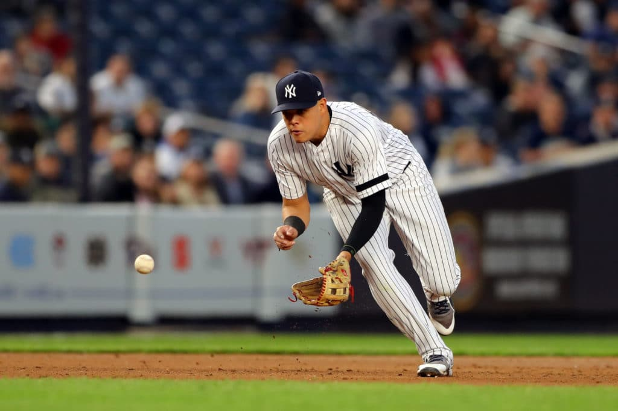
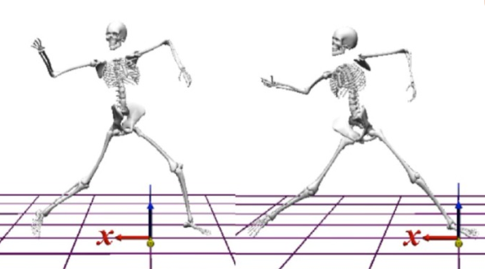
Inspiration/Motivation
In 2019, The New York Yankees set a record for the most injured players in a single season.
Not limited to one team
Why are injuries becoming more prevalent?
Kinesthetic research attempts to study the motion of pitching and its lasting impact on the body.
The Major League Baseball (MLB) organization maintains a detailed database of play-by-play statistics from 2015-2019 seasons.
This analysis will focus on injuries among pitchers.
Notes:
In 2019, The New York Yankees set a record for the most injured players in a single season. As a Yankees fan, I’ve qualitatively observed that in recent years the Yankees have seen a plethora of injuries, especially coming from their bullpen. (https://www.cbssports.com/mlb/news/yankees-set-mlb-record-for-most-injured-players-in-a-single-season-as-gio-urshela-hits-il/)
Not limited to one team: In 2018, the Diamondbacks among other teams reported an increase in players undergoing surgeries for arm/shoulder injuries.
Why are injuries becoming more prevalent?
Kinesthetic research attempts to study the motion of pitching and its lasting impact on the body.
Especially in the case of speed, rotation, and extension.
This analysis will focus on injuries among pitchers
Caveat: while focusing on solely pitchers on the injured list, I did not categorize injuries that were directly associated with pitching. For example, an injury that may have been prompted by batting or running (offensive) may be included if associated with a player who is a pitcher.

Slide 3
Data Sources and Aggregation
MLB Statcast: Data pertaining to individual pitches
Sean Lahman database: player height, weight, and age
Spottrac: keeps a record of the official MLB injured list from the past 5 seasons.
These data were combined into a Python data frame to ingest into Machine Learning Models.

Slide 4
Key Parameters
zone
release_speed
release_extension
release_spin_rate
height
weight
age
Notes:
Pitch type was excluded because of the dominating amount of fastballs thrown.

Slide 5
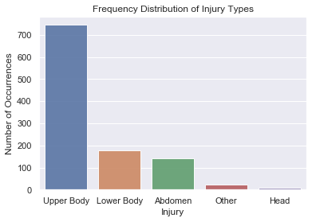
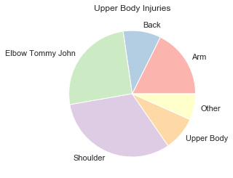
Digging into the Data

Slide 6
Digging into the Data
Feature | Elbow |  | Shoulder
 | Starting | Relief | Starting | Relief
Common Age | 28 | 28 | 28 | 29
Pitching Speed | 88.9 mph | 88.9 mph | 88.1 mph | 89.0 mph
Most Used Pitch | Four-seam Fastball | Four-seam Fastball | Four-seam Fastball | Four-seam Fastball
Pitches Per Game | 81 | 24 | 82 | 29
Average No. of Days on Bench | 92 | 86 | 64 | 59

Slide 7
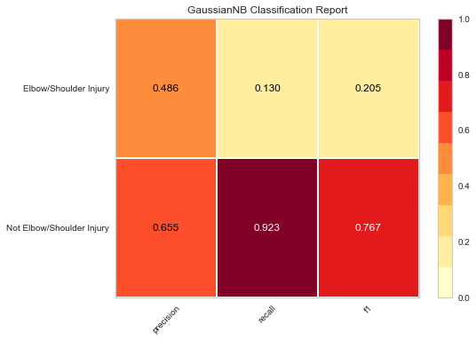
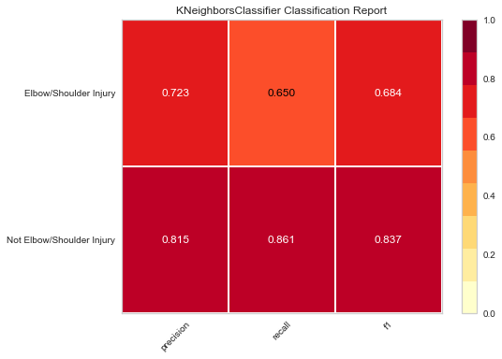
Combined Injury Classification
Gaussian accuracy: 0.640 ROC AUC: 0.527
KNeighbor accuracy: 0.785
ROC AUC: 0.755
Notes:
Precision – related to the actual results
Recall – related to the predicted results
Accuracy – predicted results related to the total

Slide 8
Model Comparison: Shoulder v. Elbow Injuries
Failure to converge!
Shoulder Injuries
Model | Accuracy | Precision | Recall | ROC AUC
Naïve-Bayes | 0.771 | 0.666 | 0.000 | 0.500
KNeighbors | 0.834 | 0.675 | 0.533 | 0.728
LinearSVC | 0.771 | 0.000 | 0.000 | 0.500
Elbow Injuries
Model | Accuracy | Precision | Recall | ROC AUC
Naïve-Bayes | 0.864 | 0.585 | 0.0023 | 0.501
KNeighbors | 0.893 | 0.661 | 0.436 | 0.700
LinearSVC | 0.864 | 0.0000 | 0.000 | 0.5000

Slide 9
Results
Kneighbor classifier labels injuries to the elbow/shoulder with a 78.5% accuracy and 0.75 ROC curve statistic.
While the accuracy is slightly better when looking at the two labels independently, combining the two labels, leads to better recall and precision statistics for both features.

Slide 10
Conclusions/Future Work
According to the data set, elbow and shoulder injuries dominate the Injured List in the past five years among pitchers.
They also are a major contributor to the overall cost/days lost to the MLB at large among injuries.
We can generate a model to classify these injuries individually among injured players or differentially classify them from a group of injuries based on player demographics and pitching statistics.
Kneighbor proves most accurate and best True Positive/False Positive (ROC) rate in both models
Future:
Take into account injury repetition
Re-train using non-injured players (is Kneighbor still best model choice?)

